Slide 1
LAN Design

Slide 2
Physical Topologies
The topology of a network is the arrangement or relationship of the network devices and the interconnections between them.
LAN topologies can be viewed in two ways:
Physical topology - Refers to the physical connections and identifies how end devices and infrastructure devices such as routers, switches, and wireless access points are interconnected.
Physical topologies are usually point-to-point or star.

Slide 3
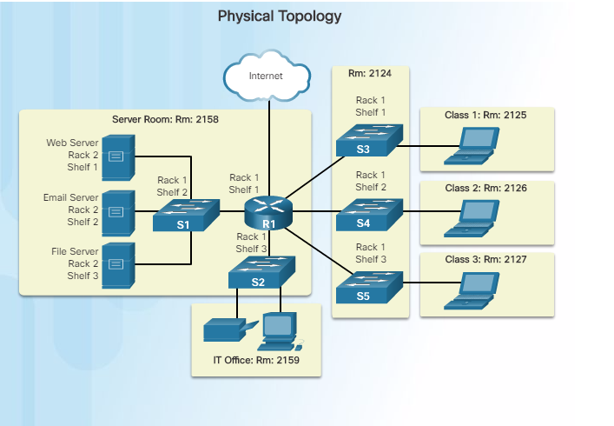

Slide 4
Logical Topologies
Logical topology - Refers to the way a network transfers frames from one node to the next.
This arrangement consists of virtual connections between the nodes of a network.
These logical signal paths are defined by data link layer protocols.
The logical topology of point-to-point links is relatively simple while shared media offers different access control methods.
The data link layer "sees" the logical topology of a network when controlling data access to the media.
It is the logical topology that influences the type of network framing and media access control used.

Slide 5
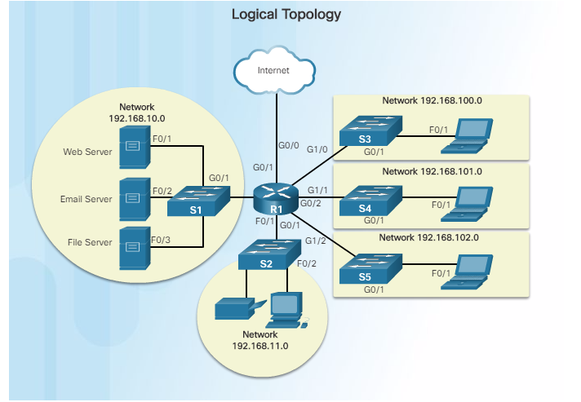

Slide 6
Physical LAN Topologies
Physical topology defines how the end systems are physically interconnected.
In shared media LANs, end devices can be interconnected using the following physical topologies:

Slide 7
Star - End devices are connected to a central intermediate device.
Early star topologies interconnected end devices using Ethernet hubs…….no hubs anymore!!!!
Hubs send out broadcasts
However, star topologies now use Ethernet switches.
The star topology is easy to install, very scalable (easy to add and remove end devices), and easy to troubleshoot.

Slide 8
Extended Star - In an extended star topology, additional Ethernet switches interconnect other star topologies. An extended star is an example of a hybrid topology.
Bus - All end systems are chained to each other and terminated in some form on each end. Infrastructure devices such as switches are not required to interconnect the end devices. Bus topologies using coax cables were used in legacy Ethernet networks because it was inexpensive and easy to set up.
Ring - End systems are connected to their respective neighbour forming a ring. Unlike the bus topology, the ring does not need to be terminated. Ring topologies were used in legacy Fibre Distributed Data Interface (FDDI) and Token Ring networks…(usually American LANs)

Slide 9
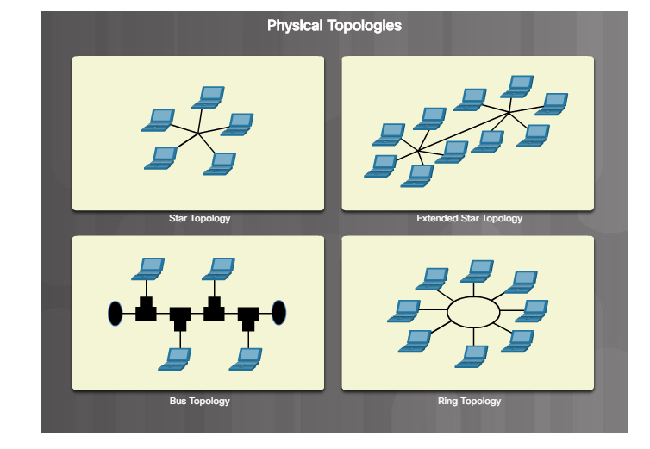

Slide 10
Ethernet LANs
Physical Topology = Extended Star
Logical Topology = Bus

Slide 11
The ability to access the Internet and the corporate network is no longer confined to physical offices, geographical locations, or time zones.
In today’s globalized workplace, employees can access resources from anywhere in the world and information must be available at any time
These requirements drive the need to build next-generation networks that are secure, reliable, and highly available.
VPNs

Slide 12
Hierarchy in the Borderless Switched Network
Creating a borderless switched network requires that sound network design principles are used to ensure
maximum availability
flexibility
security
and manageability.
The borderless switched network must deliver on current requirements and future required services and technologies.

Slide 13
Borderless switched network design must follow…
Hierarchical - Facilitates understanding the role of each device at every tier, simplifies deployment, operation, and management, and reduces fault domains at every tier
Modularity - Allows seamless network expansion and integrated service enablement on an on-demand basis
Resiliency - Satisfies user expectations for keeping the network always on
Flexibility - Allows intelligent traffic load sharing by using all network resources

Slide 14
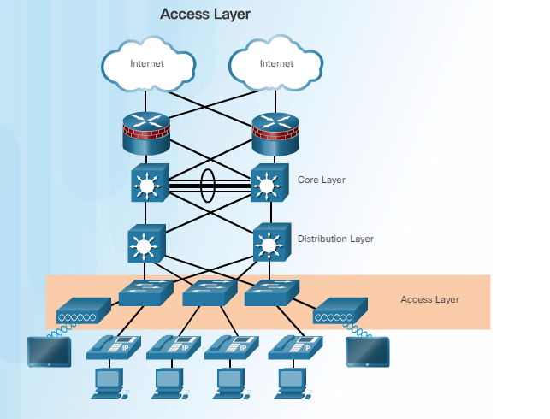

Slide 15
Access Layer
The access layer represents the network edge, where traffic enters or exits the campus network.
Traditionally, the primary function of an access layer switch is to provide network access to the user.
Access layer switches, (LES) connect to distribution layer switches (HES), which implement network foundation technologies such as routing, quality of service, and security.
To meet network application and end-user demand, the next-generation switching platforms now provide more converged, integrated, and intelligent services to various types of endpoints at the network edge.
Building intelligence into access layer switches allows applications to operate on the network more efficiently and securely.

Slide 16
Distribution Layer
The distribution layer interfaces between the access layer and the core layer to provide many important functions, including:
Aggregating large-scale wiring closet networks (IDF)
Aggregating Layer 2 broadcast domains and Layer 3 routing boundaries
Providing intelligent switching, routing, and network access policy functions to access the rest of the network
Providing high availability through redundant distribution layer switches to the end-user and equal cost paths to the core
Providing differentiated services to various classes of service applications at the edge of the network

Slide 17
Core Layer
The core layer is the network backbone.
It connects several layers of the campus network.
The core layer serves as the aggregator for all of the other campus blocks and ties the campus together with the rest of the network.
The primary purpose of the core layer is to provide fault isolation and high-speed backbone connectivity.

Slide 18
Three -tier
Campus network design for organizations where the access, distribution, and core are each separate layers.
To build a simplified, scalable, cost-effective, and efficient physical cable layout design, the recommendation is to build:
an extended-star physical network topology from a centralized building location (MDF) to all other buildings on the same campus.

Slide 19
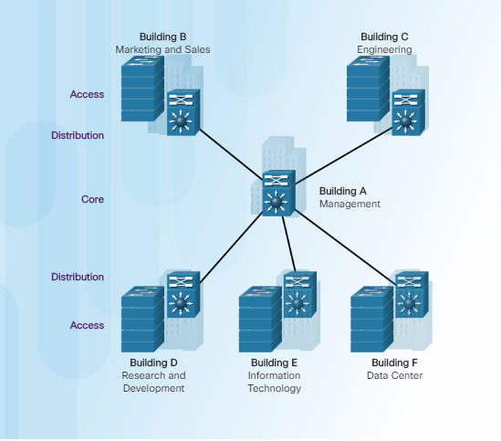

Slide 20
Switches

Slide 21
The fundamental concept of switching refers to a device making a decision based on two criteria:
Ingress port (entering a port)
Destination address (MAC)

Slide 22
LAN switches forward Ethernet frames based on the destination MAC address of the frames.

Slide 23
Switches use MAC addresses to direct network communications, (Frames), through the switch to the appropriate port toward the destination.
A switch is made up of integrated circuits and the accompanying software that controls the data paths through the switch.

Slide 24
LAN switches determine how to handle incoming data frames by maintaining the MAC address table.
A switch builds its MAC address table by recording the MAC address of each device connected to each of its ports.
The switch uses the information in the MAC address table to send frames destined for a specific device out the port which has been assigned to that device.

Slide 25
A switch populates the MAC address table based on source MAC addresses.
When a switch receives an incoming frame with a destination MAC address that is not found in the MAC address table,
the switch forwards the frame out of all ports (flooding) except for the ingress port of the frame.

Slide 26
When the destination device responds, the switch adds the source MAC address of the frame and the port where the frame was received to the MAC address table.
In networks with multiple interconnected switches, the MAC address table contains multiple MAC addresses for a single port connected to the other switches.

Slide 27
Usually in LANs with Ethernet technology the topology is
Extended Star.

Slide 28
Collapsed Backbone
Is the backplane of the HES
HES: High end switches (in the MDF)
LES: Low end Switches (in the IDFs)

Slide 29
As networks grew and enterprises began to experience slower network performance, Ethernet bridges (an early version of a switch) were added to networks to limit the size of the collision domains.

Slide 30
In hub-based Ethernet segments, network devices compete for the medium, because devices must take turns when transmitting.
The network segments that share the same bandwidth between devices are known as……

Slide 31
collision domains
because when two or more devices within that segment try to communicate at the same time, collisions may occur.
It is good to have lots of small collision domains
Switches create collision domains( good)
It is bad to have large collision domains (hubs)

Slide 32
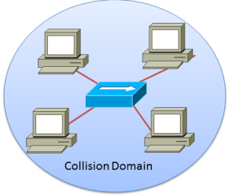
1 Hub with 1 large collision domain

Slide 33
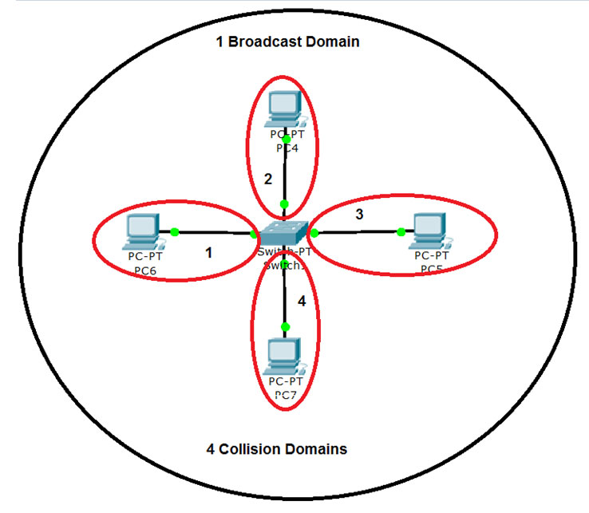
Switch creates 4 small CDs and 1 Broadcast Domain (micro-segmentation)

Slide 34
Collision and Broadcast Domains
It is possible, however, to use other network devices (examples would include switches and routers) operating at the TCP/IP model and above to divide a network into segments and reduce the number of devices that compete for bandwidth.
Routers create both CDs and BDs
Switches create CDs ( as mentioned several times)
Switches with VLANs create BDs

Slide 35
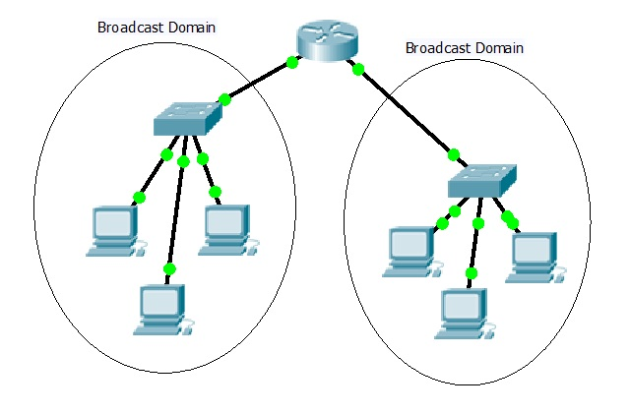
Router with 2 BDs

Slide 36
Microsegmentation
Each new segment results in a new collision domain.
More bandwidth is available to the devices on a segment, and collisions in one collision domain do not interfere with the other segments.
This is also known as micro-segmentation.

Slide 37
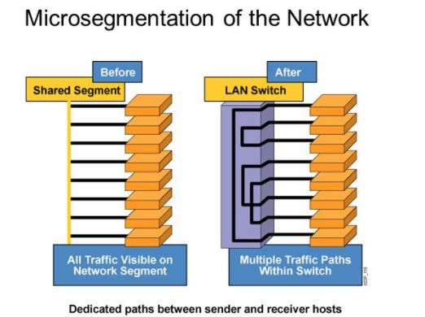
Micro- segmentation
When each device has a dedicated link to a port on a switch.

Slide 38
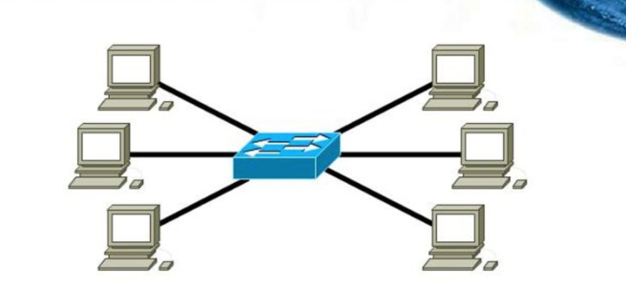
Micro- segmentation

Slide 39
Switches do not create B.Domains …. (unless VLANs configured)
Although switches filter most frames based on MAC addresses, they do not filter broadcast frames.
For other switches on the LAN to receive broadcast frames, switches must flood these frames out all ports.
A collection of interconnected switches forms a single broadcast domain.

Slide 40
Broadcast Domain
Only a network layer device, such as a router, can divide a Layer 2 broadcast domain.
Routers are used to segment both collision and broadcast domains.
When a device sends a Layer 2 broadcast, the destination MAC address in the frame is set to all binary ones.
A frame with a destination MAC address of all binary ones is received by all devices in the broadcast domain.
The Layer 2 broadcast domain is referred to as the MAC broadcast domain.

Slide 41
When a switch receives a broadcast frame, it forwards the frame out each of its ports, except the ingress port where the broadcast frame was received.
Each device connected to the switch receives a copy of the broadcast frame and processes it.

Slide 42
Broadcasts
Broadcasts are sometimes necessary for initially locating other devices and network services, but they also reduce network efficiency.
Network bandwidth is used to propagate the broadcast traffic.
Too many broadcasts and a heavy traffic load on a network can result in congestion.

Slide 43
LAN switches have special characteristics that make them effective at alleviating network congestion.
First, they allow the segmentation of a LAN into separate collision domains.
Each port of the switch represents a separate collision domain and provides the full bandwidth to the device or devices that are connected to that port.

Slide 44
Second, they provide full-duplex communication between devices.
A full-duplex connection can carry transmitted and received signals at the same time.
Full-duplex connections have dramatically increased LAN network performance, and are required for 1 Gb/s Ethernet speeds and higher.

Slide 45
Switches interconnect LAN segments (collision domains), use a table of MAC addresses to determine the segment to which the frame is to be sent, and can lessen or eliminate collisions entirely.

Slide 46
Switches with VLANs create broadcast domains.

Slide 47
VLANs
A VLAN is a group of PCs, servers and other network resources that behave as if they were connected to a single, network segment — even though they may not be.
For example, all marketing personnel may be spread throughout a building.
Yet if they are all assigned to a single VLAN, they can share resources and bandwidth as if they were connected to the same segment.
The resources of other departments can be invisible to the marketing VLAN members, accessible to all, or accessible only to specified individuals, at the IT manager's discretion.

Slide 48
Wiring closets
Determine where the MDF is going to be located.
Green field site.
Determine how many network nodes you will have in each area of the LAN.
The number of network nodes will determine the number of switches.
Each network node has a dedicated link to a port on a switch….
Hence number of ports = number of network nodes.
MICROSEGMENTATION!!

Slide 49
Wiring closets
Once you have calculated number of switches this will translate into number of IDF’s and placement of IDF’s.
High density of nodes in particular areas with mean more IDF’s in the area.
Remember each building requires a minimum of one IDF per floor.
Area covered per IDF depends on cabling to are using.
Cabling on maps needs to be colour coded.

Slide 50
VLAN’s
VLAN per …
Staff
Student
Administration
Co lab
An Danlann
Etc….

Slide 51
Switches
How many HES?
How many LES?
Specification of HES
Specification of LES

Slide 52
Servers
Approxmiate the specification for servers…
Example:
File Servers (calculate storage needed)
Application servers
Web server
DNS
DHCP
Mail …..

Slide 53
IP addressing
How many subnets?
Which address is used?
Specification of router.

Slide 54
Voice over IP
WLAN’s ….overage and how many access points?
Physical security of wiring closets
Sniffer software
WAN link to Killybegs

Slide 55
LAN Design Report
Any decisions in your design you make should be justified.
Report should have a small introduction of aims of your LAN design..
Performance
Redundancy
Scalability
Security
Manageability
Convergence
Traffic Flow Analysis

